Slide 1
iPad as a Learning Center Workshop
Center Activity Examples
Laura Caulin ~ Technology Professional Development Consultant

Slide 2
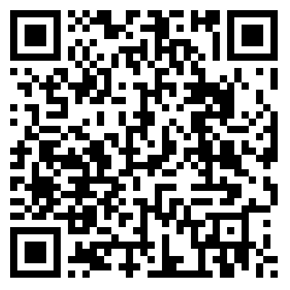
Scan this code from INSIDE the See Saw app
to get to our class.

Slide 3
School Rules
Materials
1 iPad with the SeeSaw app
Directions
Open the SeeSaw app.
Tap Drawing.
Draw a picture illustrating an important classroom rule.
Tap the green check.
Tap the T.
Type the rule.
Tap Done
Tap the microphone.
Record what you wrote.
Tap the red button when you are done recording.
Tap the check.
Tap the check again.
Tap your name.
Tap the check.

Slide 5
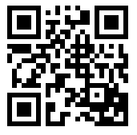
Understanding Pronouns
Materials
iPad with the Scan App
Worksheet
Pencil
Directions
Open the Scan App.
Scan the QR code to get to the Understanding Pronouns video.
Have the worksheet and a pencil ready.
Click
Follow the directions in the video.

Slide 6
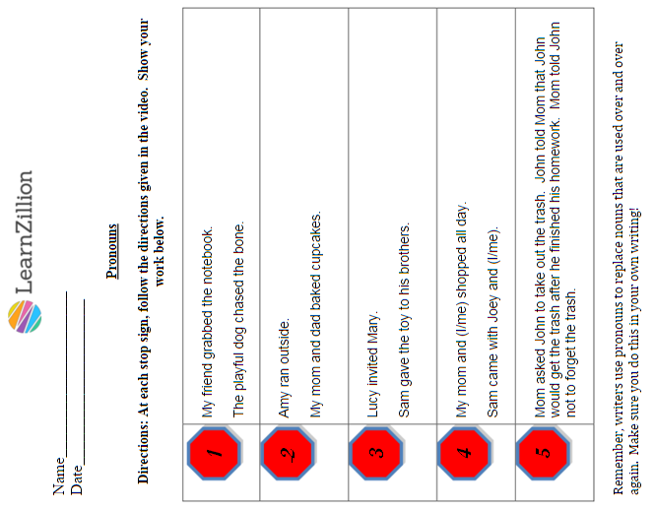
This worksheet can be found at https://learnzillion.com/lesson_plans/5564-understand-pronouns#fndtn-additional-material

Slide 7
Making One Dollar – 4 Ways
$
1 iPad (See Saw app)
Math Manipulatives
Materials
Directions
Use the math organizer and money manipulatives to show $1.00 four different ways.
Open the See Saw app.
Tap Photo.
Tap the camera to take a picture of your work.
Tap the microphone.
Explain your work.
Tap the check.
Tap the check again.
Tap your name.
Tap the check.
Tap the arrow to the right to get the app ready for the next group.

Slide 8
$ 1.00
$ 1.00
$
$ 1.00
$ 1.00

Slide 9
Life Cycle of a Butterfly
Materials
1 iPad (Camera and See Saw apps)
Life cycle pictures
Directions
Put the butterfly life cycle pictures in order.
Go to the camera app.
Change the mode to video.
Record each other explaining the stages of a butterfly’s life cycle. Follow the directions on the right to put it in See Saw. (Each person explains the whole cycle.)
Go to the See Saw app.
Tap Camera Roll.
Tap Camera Roll.
Tap your video.
Tap the check.
Tap your name.
Tap the check again.

Slide 10
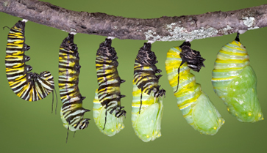
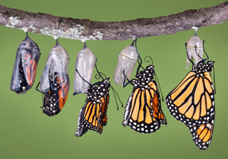
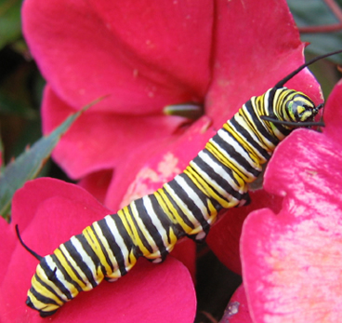
Adult butterfly
egg
pupa
larva

Slide 11
Things to Think (or Write) About
Materials
iPad (Things to Think About App)
Ipad (iBrainstorm App)
Directions
Go to the Things to Think About app.
Tap Categories.
Tap Rules.
Choose one of the prompts to explore.
Go to the iBrainstorm app.
Tap the triangle in the center of screen.
Tap the plus sign.
Type your names.
Tap Save.
Tap the plus sign above the faces.
Double-tap on the sticky note to type an idea.
Add more notes and type more ideas.
When you are done, tap the Share icon.
Tap mail.
Email your page to Mrs. Caulin.

Slide 12
Rules for using the iPad Center
Wash your hands before using the iPad.
No water near the iPad.
Use only apps in the instructions for the center.
Always share with others in your group.
Be gentle when touching the screen.
Leave the iPad on the table unless you are taking a picture.
Leave the iPad ready for the next users.

